Slide 1

Gore Autonomous Pinecone Collector
Tyler Rottkamp, Elijah Gerstner, Kyle Zarycki, Siyu Yu ​

Slide 2

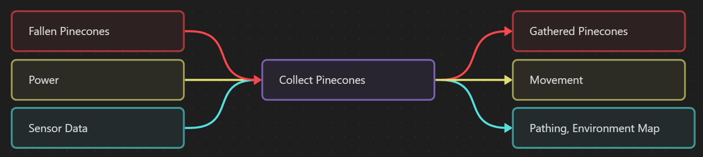
Project Description
g
Goal:
Design a robot to automatically collect fallen Ponderosa Pinecones on yard or forest terrain
Importance:
-Improve efficiency vs. manual collection
-Support forestry research & sustainable practices
-Gain hands-on robotics & mechanical design experience
Sponsor:
W.L. Gore
Black Box

Slide 3
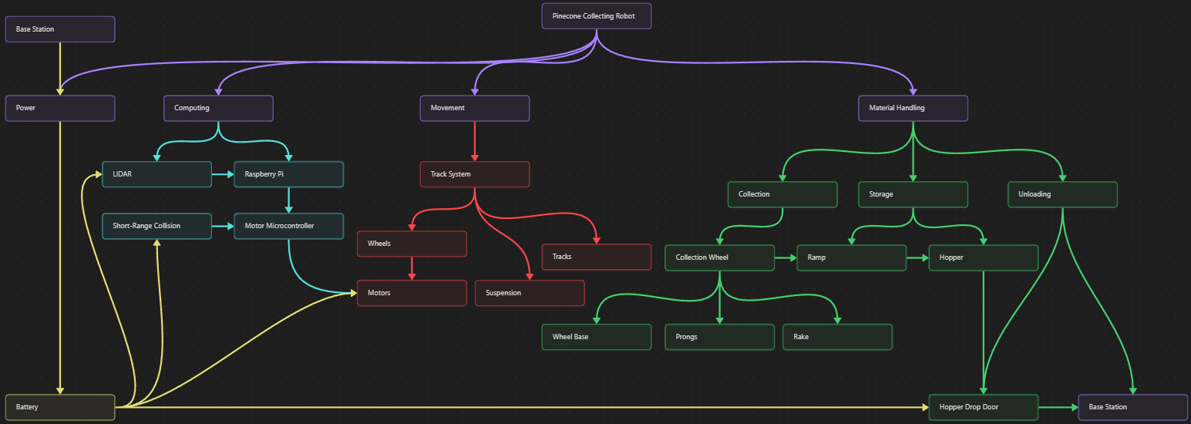
Functional Decomposition

Slide 4
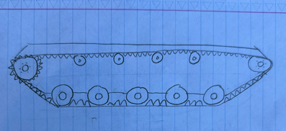
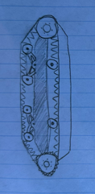
Concept Generation : Suspension
Rigid Track System
Pros
Simple and durable
Cheap
Cons
Reduced traction
Higher stress on frame
Vertical Volute Spring Suspension (VVSS)
Pros
Compact orientation
Robust
Cons
Difficult assembly
Complex at smaller scales

Slide 5
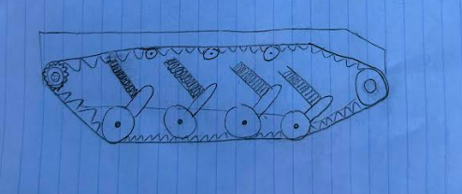
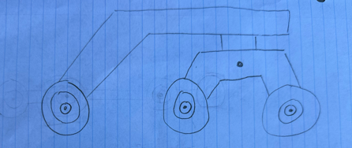
Concept Generation : Suspension
Coil Spring Suspension
Pros
Balance between simplicity and performance
Easy to change spring stiffness
Cons
Bulkier that rigid designs
Springs can degrade over time
Rocker-Bogie Suspension (Wheeled)
Pros
Good terrain adaptability
Cons
No shock absorption
Steering systems are more exposed
Not as much traction as tracked systems
Kyle 10/08/25, PCC, P2

Slide 6



Engineering Calculations: Suspension
Weight
W=mg
Spring Selection
$$F_{w}=\frac{W}{n}$$
Fs= FoS*Fw
$k=\frac{F_{s}}{∆x}$
Track width
$$b=\frac{W}{2P_{max}L}$$
$$A_{track}=2bL$$
Traction
$$F_{tm}=μW$$
$$F_{r}=C_{r}W$$
$$F_{slope}=Wsinθ+C_{r}cos$$
Motor Selection
$$T=F_{tm}∗r_{w}$$
$$P=F_{tm}∗v$$
[3]
[10]
Kyle 10/08/25, PCC, P2

Slide 7



Engineering Calculations: Suspension
Weight
W = 196.2N
Spring Selection
$F_{w}=\frac{196.2N}{8}=24.525N$
Fs= 1.5*24.525= 36.79N
$k=\frac{36.79}{0.0762}=$482.78N/m
Track width
$$b=\frac{392.4N}{2∗10,000 \frac{N}{m^{2}}∗0.61m}$$
b= 32 mm
$$A_{track}=2∗.05m∗0.6096m$$
A=0.061m^2
Traction
$$F_{tm}=0.2∗392.4=78.48N$$
$F_{slope}=392.4sin⁡(30)+0.2cos⁡($30)
F=196.4N
Motor Selection
$$T=196.4N∗0.05m$$
T=9.82 Nm
$$P=196.4N∗2m/s$$
P=392.8W
[3]
Kyle 10/08/25, PCC, P2

Slide 8
Concept Evaluation : Suspension
Rigid system was used as a baseline
Rocker bogie is to complex for this project
VVSS provides a good compromise
Coil Spring is the best overall option
Criterion | Weight | Rigid | VVSS | Coil Spring | Rocker Bogie
Simplicity | 2 | 5 | -2 | -1 | -2
Terrain mobility | 3 | 2 | +1 | +2 | +2
Cost | 3 | 5 | -2 | -1 | -2
Durability | 2 | 2 | -1 | +2 | -1
Weight | 1 | 5 | -2 | -1 | -1
Ease of instalment | 1 | 5 | -2 | -1 | -3
Kyle 10/08/25, PCC, P2

Slide 9
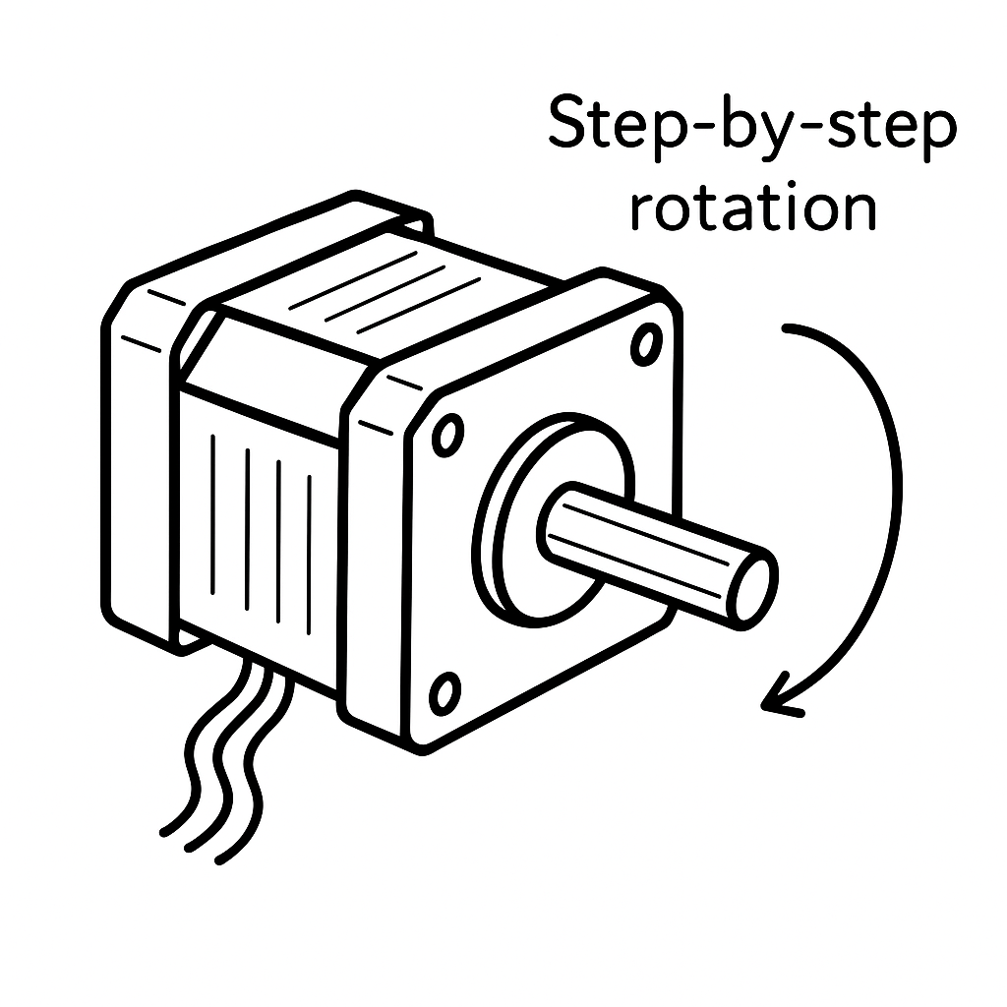
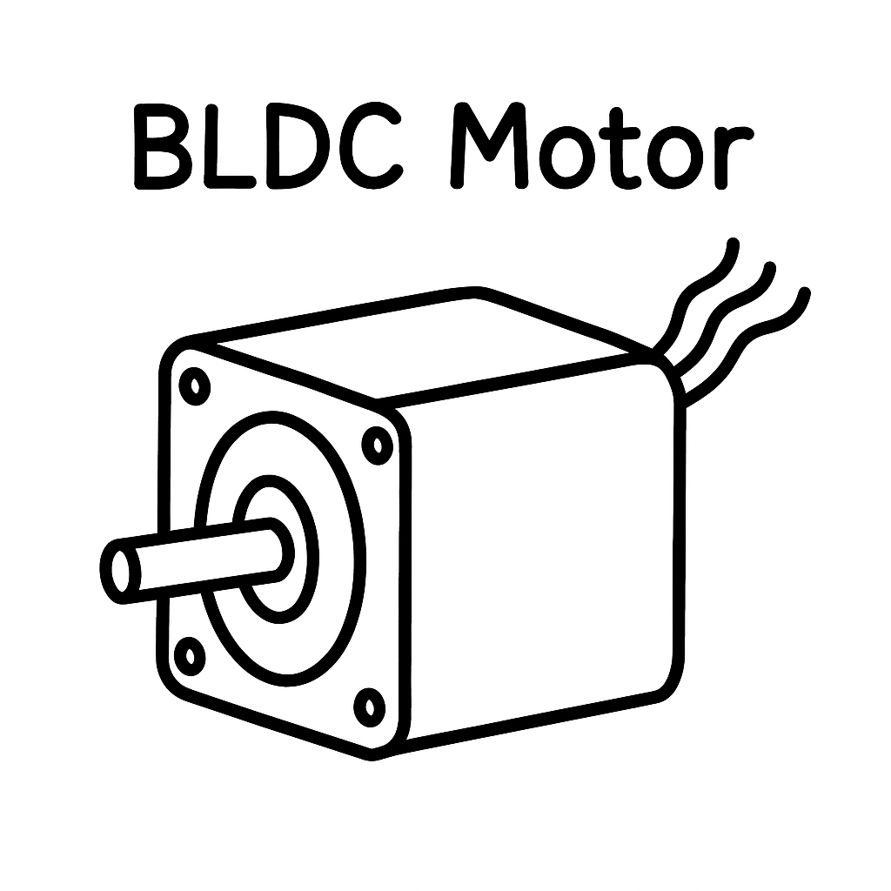
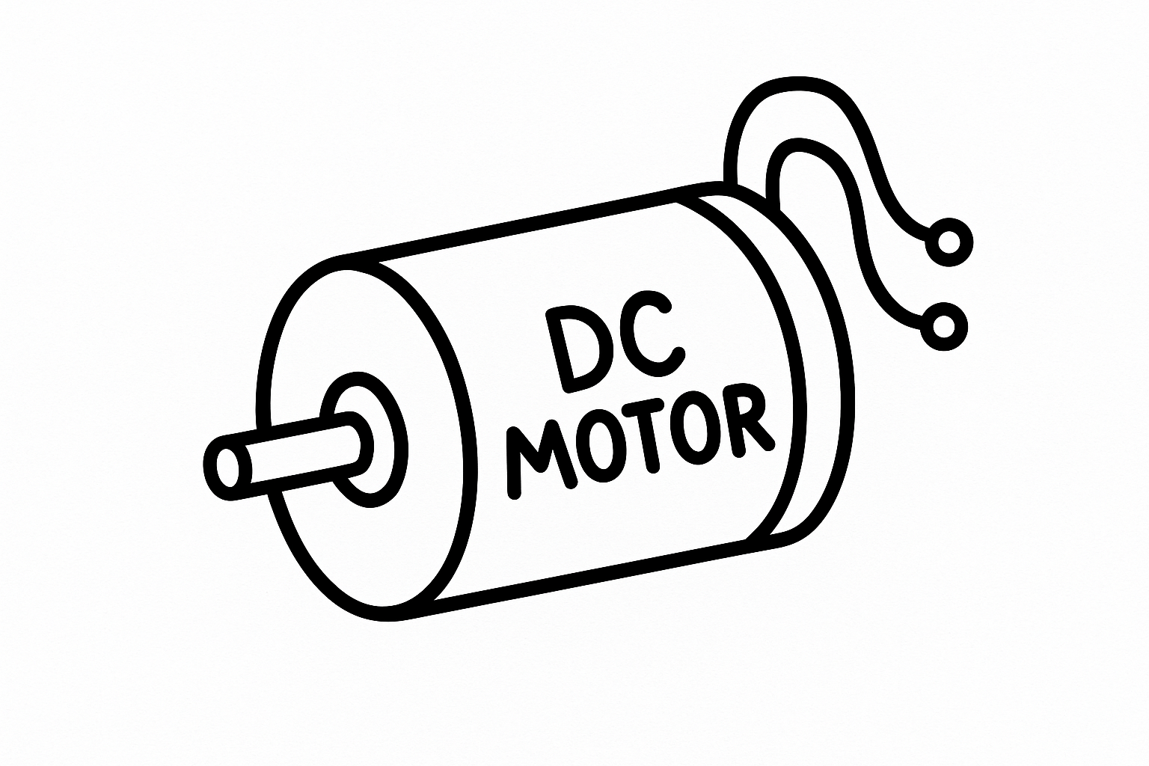
Concept Generation : Motors
Design 1：DC Motor
Design 2:Stepper Motor
Design 3:BLDC Motor
Function: Drives the spike wheel or brush roller to collect pinecones; converts battery power into rotational motion.
Pros:
Simple & low cost
High starting torque
Easy speed control
Cons:
Low efficiency at high load
Brush wear over time
Less precise control
Function: Controls precise rotation of the spike wheel for accurate and repeatable pinecone collection.
Pros:
High positioning accuracy
Smooth low-speed motion
Moderate cost
Cons:
Torque drops at high speed
Needs driver circuit
Can lose steps under heavy load
Function: Provides high-efficiency, long-lasting power for the main collection mechanism through smooth and stable rotation.
Pros:
High efficiency & long lifespan
Quiet and low maintenance
Stable torque output
Cons:
Higher cost
Complex control circuit
Lower torque at very low speed
Siyu 10/08/25, PCC, P2

Slide 10
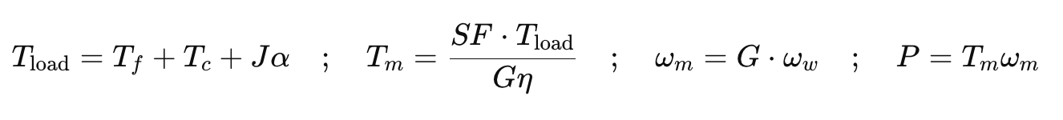
Engineering Calculations: Motors
Purpose: To estimate the required torque, speed, and power for the spike wheel motor of the Pinecone Collector based on the desired ground speed and load conditions.
Assumptions:
Roller radius r = 0.12 m
Target surface speed v = 2.4 m/s
Acceleration time tₐ = 0.25 s
Gear ratio G = 10 : 1, efficiency η = 0.8
Bearing friction torque T_f = 0.1N·m
Ground contact torque T_c = 1.0 N·m
Roller inertia J = 0.0015 kg·m²
Safety factor SF = 2.0
Key Equations:
Parameter | Symbol | Result
Motor speed | ωm | ≈200rad/s(≈ 1910 rpm)
Motor torque | Tm | 0.575 N·m
Power required | P | ≈ 115 W
The calculated torque and power confirm that a small 12 V DC gear motor or NEMA 17 stepper provides sufficient performance and reliability for the spike-wheel motion, with an adequate safety margin.
Siyu 10/08/25, PCC, P2

Slide 11
Concept Evaluation : Motors
Comparison (1-5,higher is better)
Choose: DC Gearmotor
Provides sufficient torque and speed (~0.1 N·m, ≈ 480 rpm)
Simple control (PWM), no need for ESC or complex driver
Low cost and easy replacement for student prototype use
Stable performance under variable ground resistance
The BLDC motor offers better efficiency and quietness but requires extra components (ESC, tuning). The stepper motor provides position precision but lower efficiency and risk of missed steps.
Criterion | Weight | DC Gearmotor | Stepper | BLDC
Meets torque & speed | 0.3 | 5 | 4 | 5
Efficiency / runtime | 0.2 | 3 | 2 | 5
Control & cost simplicity | 0.25 | 5 | 3 | 2
Robustness / maintenance | 0.15 | 4 | 3 | 5
Noise / smoothness | 0.1 | 3 | 3 | 5
Weighted score | 1 | 4.3 | 3.2 | 4
DC gearmotor is the best overall option, balancing performance, simplicity, and reliability for the Pinecone Collector.
Siyu 10/08/25, PCC, P2

Slide 12
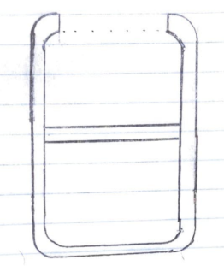
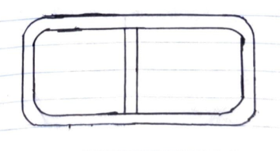

Concept Generation : Frame
Concept 2 uses the same base while adding sheet metal to protect the machinery
Concept 3 creates a second level, where the first level looks like concept 1
Concept 1 uses metal pipes
Pros: Lightweight, roller/collection in the front, less track required, and the cheapest material cost.
Cons: No great mounting area, and weak structurally
Pros: Better mounting, lightweight, and sheet metal
Cons: Poor motor protection, and pooling in the sheet metal
Pros: Better motor protection, collision resistant, and best stability
Cons: Much heavier, higher material cost, and more power required
Tyler 10/08/25, PCC, P2

Slide 13
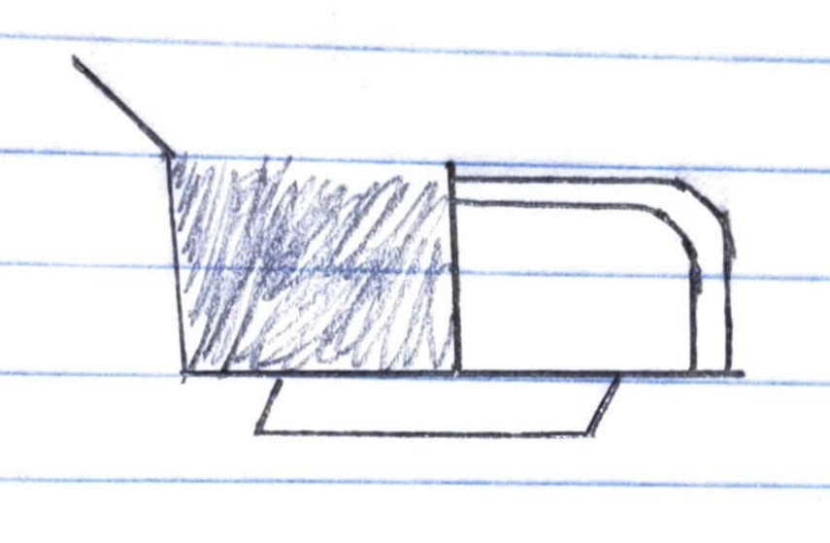
Concept Generation : Frame
Concept 4 uses sheet metal to build the majority of the body, with pipes for support/housing.
Pros: Cheaper machining costs, motor protection, good storage space
Cons: Roller in the back of the machine, non-removable collector, and poor collection due to tracks
Tyler 10/08/25, PCC, P2

Slide 14


Engineering Calculations: Frame
Properties | Aluminum 6063_T6 | Aluminum 6063_T5 | 304 Stainless Steel
Density | 0.0975 lb/in^3 | 0.0975 lb/in^3 | 0.286 lb/in^3
Ultimate Tensile Strength | 35000 psi | 27000 psi | 75000 psi
Tensile Yield Strength | 31000 psi | 21000 psi | 30000 psi
Modulus of Elasticity | 10000 ksi | 10000 ksi | 28000 ksi
Machinability | 50% | 50% | 43%
Price per Pound | $0.60 | $0.60 | $1.54
Tyler 10/08/25, PCC, P2

Slide 15
Concept Evaluation: Frame
Criterion | Weight | Concept 1 | Concept 2 | Concept 3 | Concept 4
Easy Collection Integration | 0.25 | 4 | 4 | 4 | 2
Collision Resistance | 0.25 | 2 | 3 | 5 | 4
Cost | 0.20 | 5 | 4 | 3 | 4
Structural Integrity | 0.15 | 2 | 3 | 5 | 4
Weight | 0.15 | 5 | 5 | 4 | 4
Weighted score | 1 | 3.55 | 3.75 | 4.2 | 3.5
Chose Concept 3 because it was the best balance of all the desired parameters. The material choice will be Aluminum 6063-T6 because it's weight and cost are significantly better than stainless steel for this application. It recieves the nod over the T-5 because it has slightly higher strength values.
Tyler 10/08/25, PCC, P2

Slide 16
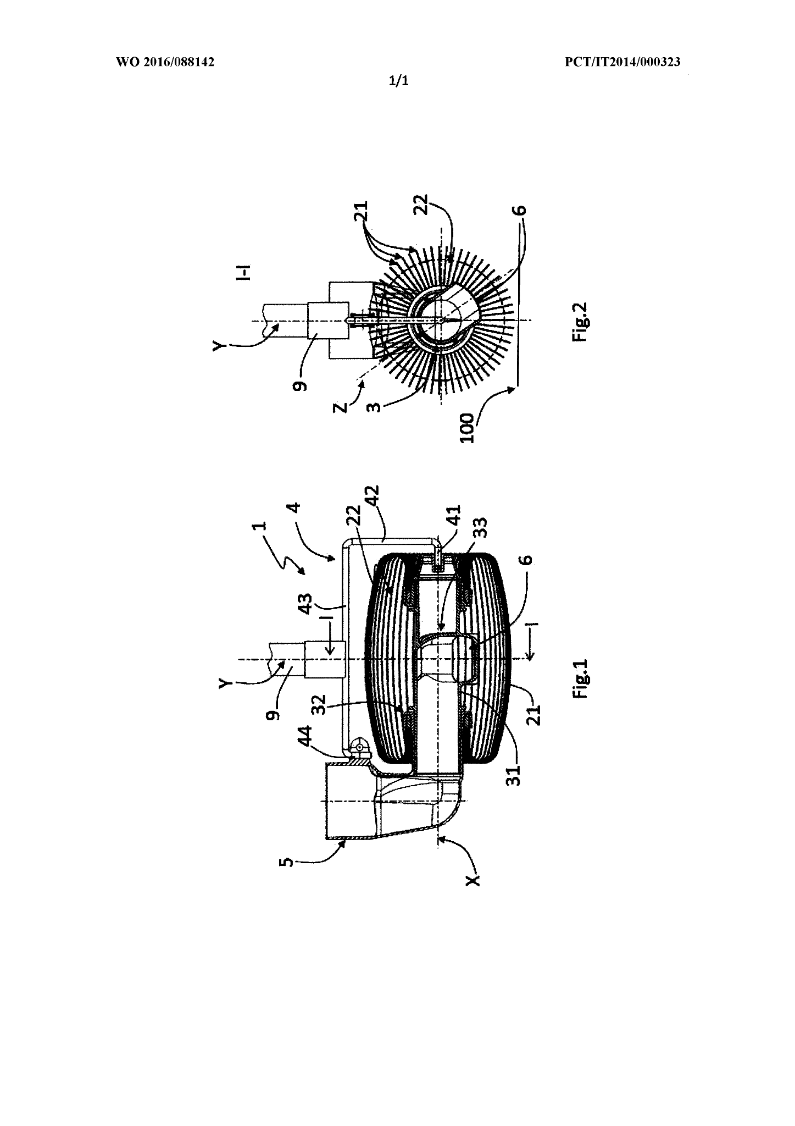
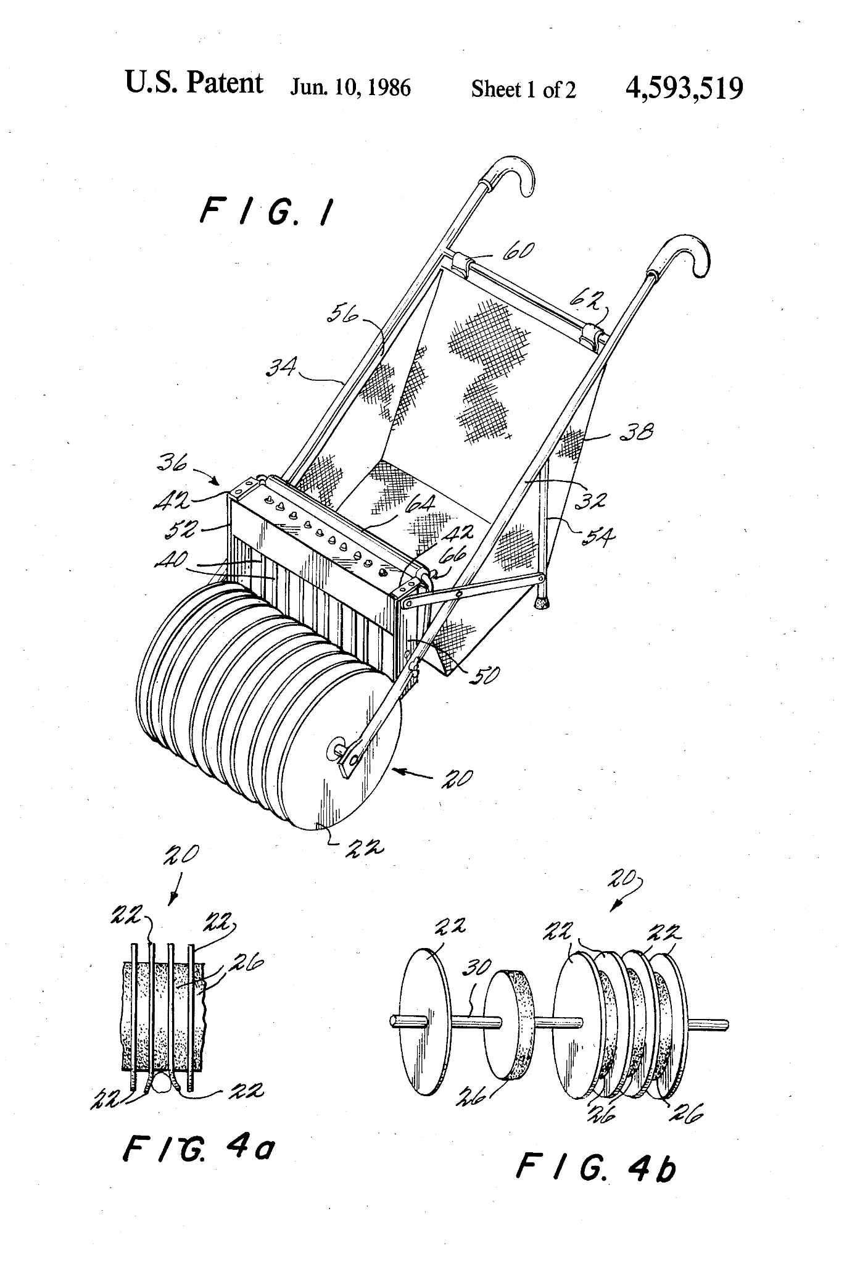
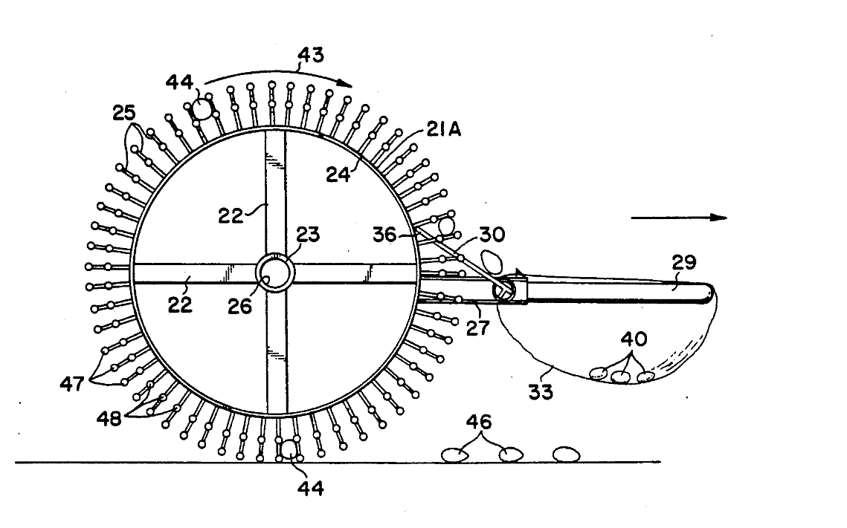
Concept Generation: Collection p.1
[1]
[2]
Wire Cage:
-Low-cost materials & little material used
-No chance of captured objects falling out
-Best for smaller & smoother objects like nuts or golf balls
-Contents must be unloaded from the side
"Prong":
-High capture effectiveness
-Easy to dislodge captured objects
-Individual prong repair
-Room for innovation
-Harder to manufacture at small-scale
Disk:
-Simple to design
-High structural stability (especially as a supporting wheel)
-Higher material cost
-Has a narrow range of capturable objects (Disk Spacing)
-Few ways to innovate/iterate
Eli 10/08/25, PCC, P2

Slide 17
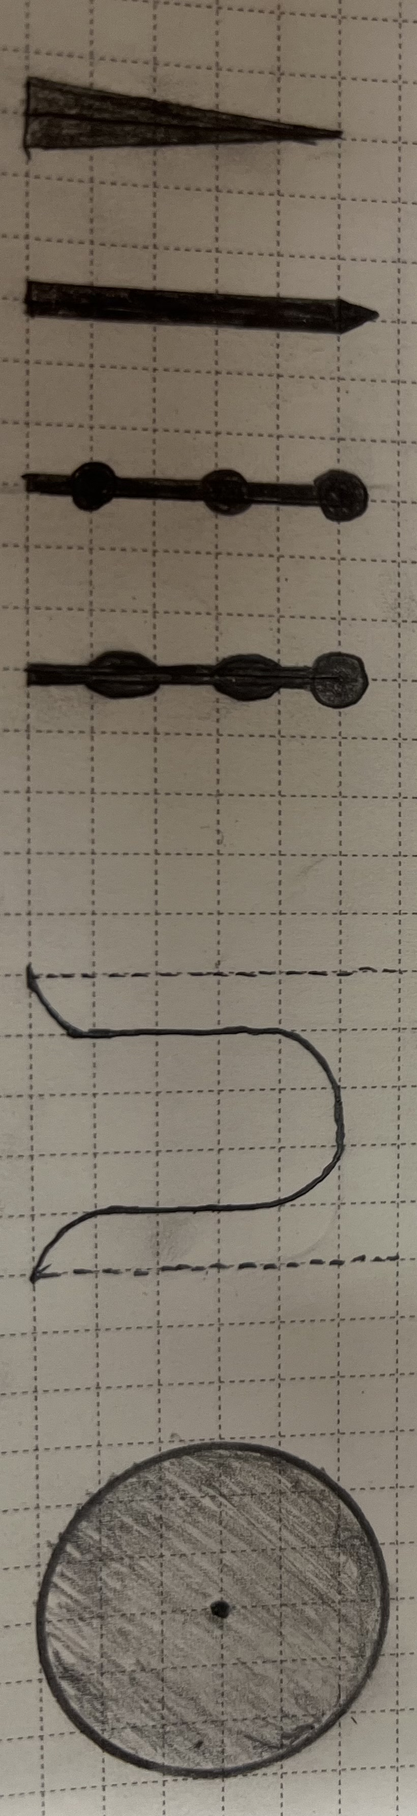
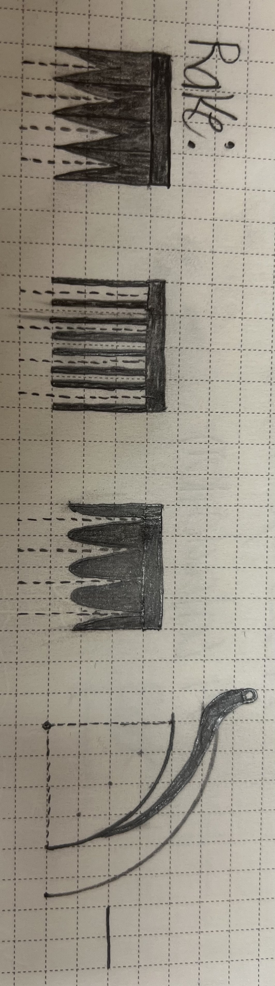
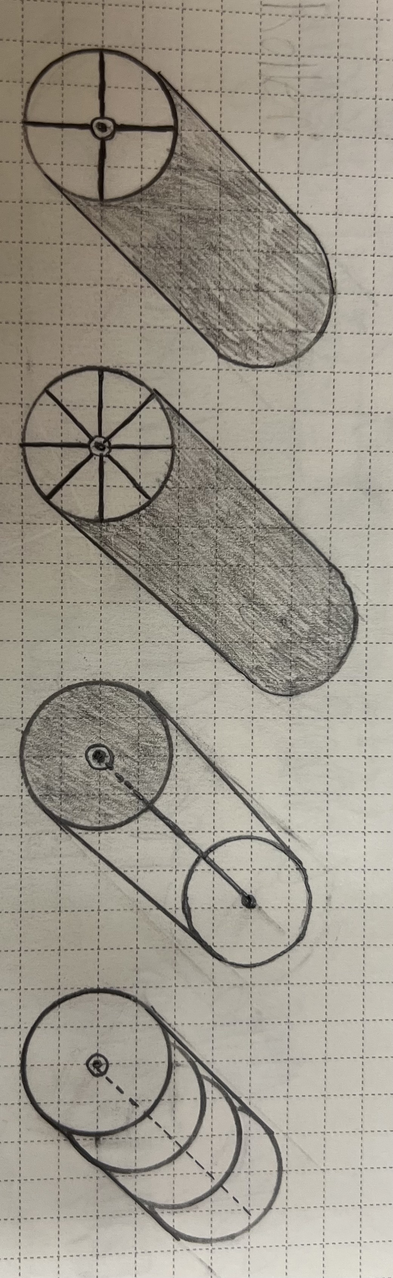
Concept Generation: Collection p.2
 | 1 | 2 | 3 | 4 | 5 | 6
Capture
Rake
Structure
Eli 10/08/25, PCC, P2

Slide 18




Engineering Calculations: Collection
Eli 10/08/25, PCC, P2
Area Moment of Inertia (Circular)
Elastic Bending
(Tip Rotation)
Root Bending Stress
Yield Force
Symbol | Meaning | Units
(L) | Prong length | m
(d) | Prong diameter | m
(b) | Prong width | m
(h) | Prong thickness | m
(E) | Young’s modulus (material stiffness) | Pa
(sigma_y) | Yield strength | Pa
(Theta) | Bend angle at prong tip | rad
(c) | Distance from neutral axis to outer fiber | m
4 Example Cases at 30-Degree Bending:
Design | Material | d (mm) | L (in / mm) | (P) required (N)
A | PLA | 6.0 | 1.5 in / 38.10 mm | 112.4 N
B | PETG | 4.0 | 2.0 in / 50.80 mm | 13.8 N
C | ABS | 5.0 | 2.5 in / 63.50 mm | 34.6 N
D | Nylon (PA) | 6.0 | 3.0 in / 76.20 mm | 34.4 N

Slide 19
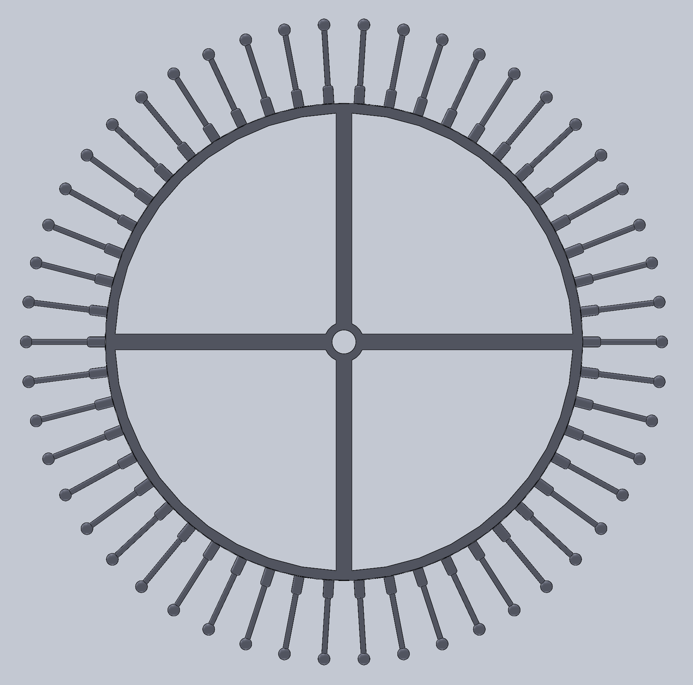
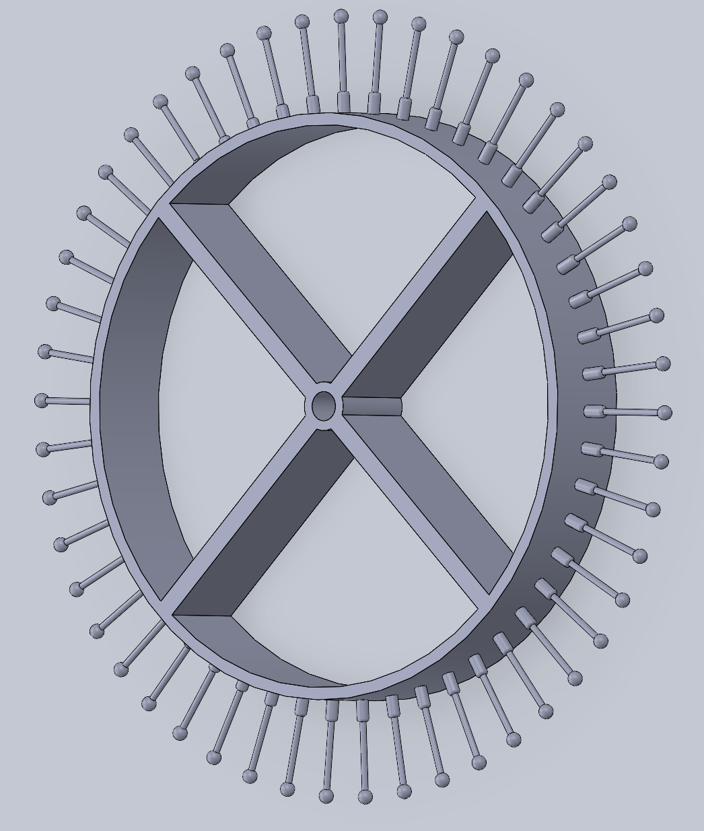
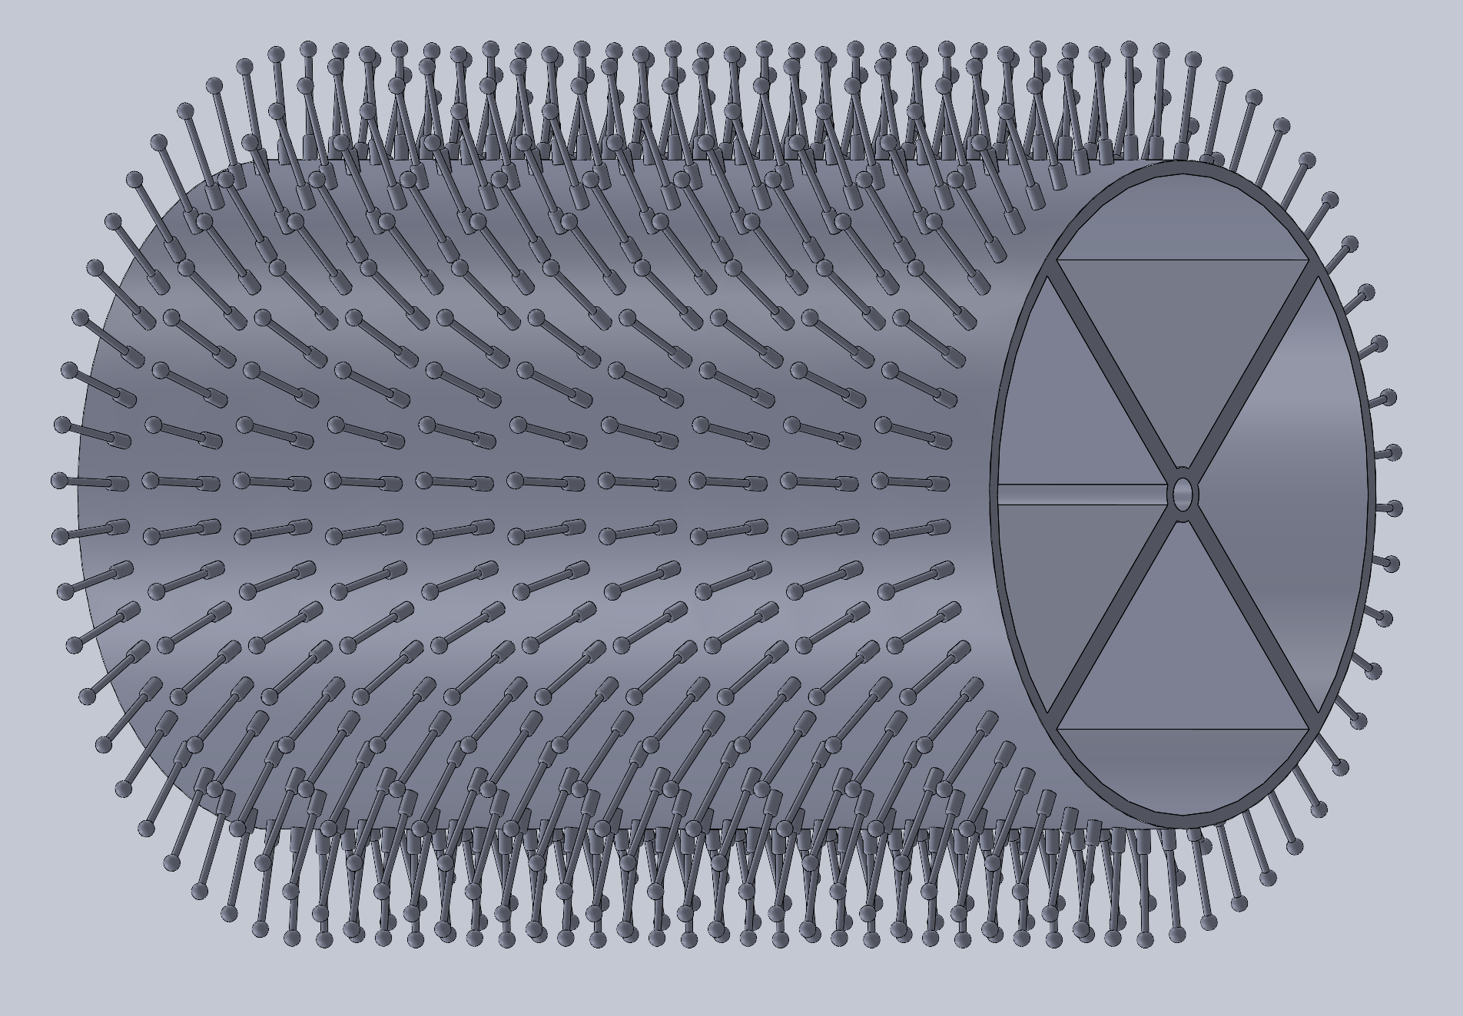
Concept Evaluation : Collection
Eli 10/08/25, PCC, P2
Criteria | Weight
Effectiveness | .35
Manufacturability | .3
Cost | .2
Durability | .15
 | 1 | 2 | 3 | 4 | 5 | 6
Capture | 4.5 | 5.2 | 8.6 | 7.5 | 6.3 | 7.0
Rake | 7.2 | 8.4 | 6.8
Structure | 9.1 | 6.2 | 8.5 | 6.8

Slide 20
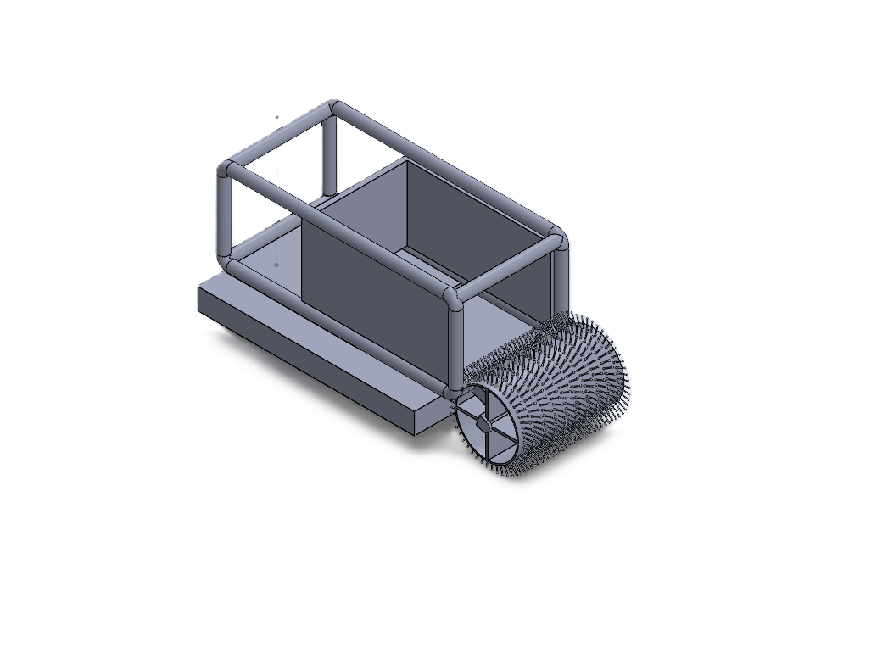
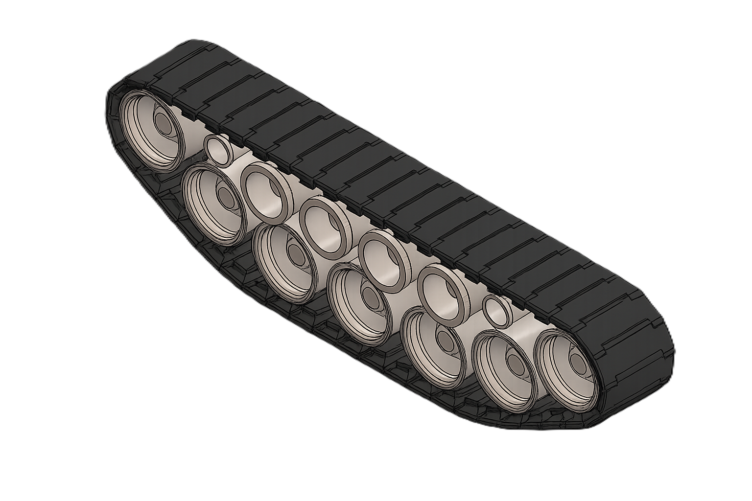
CAD Model
Eli 10/08/25, PCC, P2

Slide 21
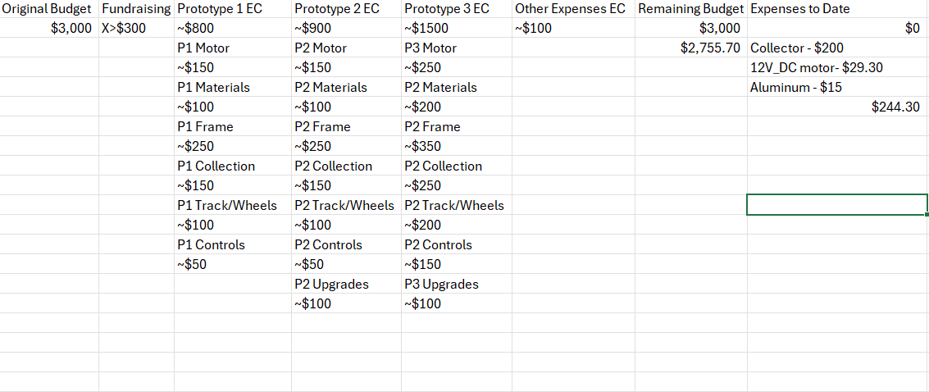
Budget
Tyler 10/08/25, PCC, P2

Slide 22
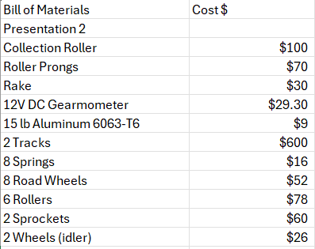
Bill of Materials
All prices are subject to change throughout the design process.
We are missing our circuitry and sensors because the EEs are responsible for selecting those.
Some parts will be reused so we won't go over budget.
Tyler 10/08/25, PCC, P2

Slide 23
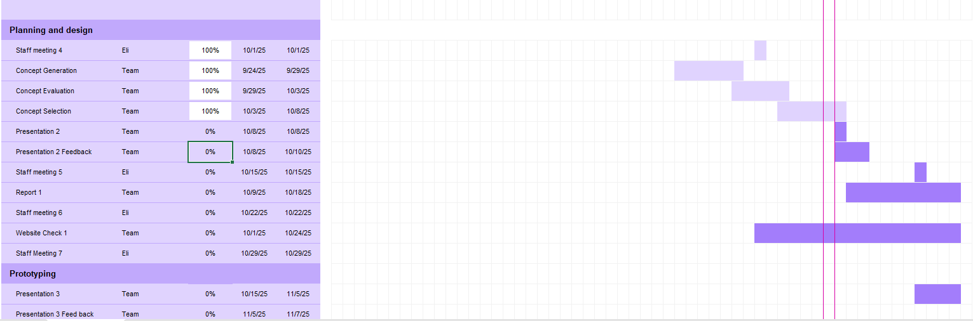
Schedule
Kyle 10/08/25, PCC, P2

Slide 24
Next Steps
Visit RAZ lab to view the Robot Utility Tank project
Work with Electrical engineers to create an initial prototype
Determine how to raise funds
Finish report one
Update website
Kyle 10/08/25, PCC, P2

Slide 25
References
[1]“US4593519A - Apparatus for picking up objects randomly distributed on a surface - Google Patents,” Google.com, Sep. 22, 1983. https://patents.google.com/patent/US4593519A/en (accessed Oct. 09, 2025).
[2]“US5025620A - Nut harvesting apparatus - Google Patents,” Google.com, Jul. 26, 1990. https://patents.google.com/patent/US5025620A/en (accessed Oct. 09, 2025).
[3]“Rolling resistance coefficient for real world roads,” ResearchGate, 2021. https://www.researchgate.net/figure/Rolling-resistance-coefficient-for-real-world-roads-13_tbl2_351973711
[4]Surplus Center, “DC Motors | Electrical,” SurplusCenter.com, accessed Oct. 8, 2025. https://www.surpluscenter.com/Electrical/DC-Motors/
[5]“ASM Material Data Sheet,” asm.matweb.com. https://asm.matweb.com/search/SpecificMaterial.asp?bassnum=MA6063T5
[6]“ASM Material Data Sheet,” asm.matweb.com. https://asm.matweb.com/search/SpecificMaterial.asp?bassnum=MA6063T6
[7]Andrew, “304 Stainless Steel Properties - Physical, Mechanical Properties,” 304 Stainless Steel. https://304stainlesssteel.org/304-stainless-steel-properties/#google_vignette
[8] “Aluminum 6063,” iScrap App, Feb. 28, 2025. https://iscrapapp.com/metals/aluminum-6063/
[9] “Volume of a Cylinder Calculator,” www.omnicalculator.com. https://www.omnicalculator.com/math/cylinder-volume
[10]Budynas, Shigley’s Mechanical Engineering Design, 11Th Edition, Si Units. S.L.: Mcgraw-Hill Education (As, 2020.
[11]“Brushless DC electric motor,” Wikipedia, accessed October 8, 2025https://en.wikipedia.org/wiki/Brushless_DC_electric_motor
[12]“Stepper motor,” Wikipedia, accessed October 8, 2025. https://en.wikipedia.org/wiki/Stepper_motor
Notes:
Thanks for your time!

